Slide 1

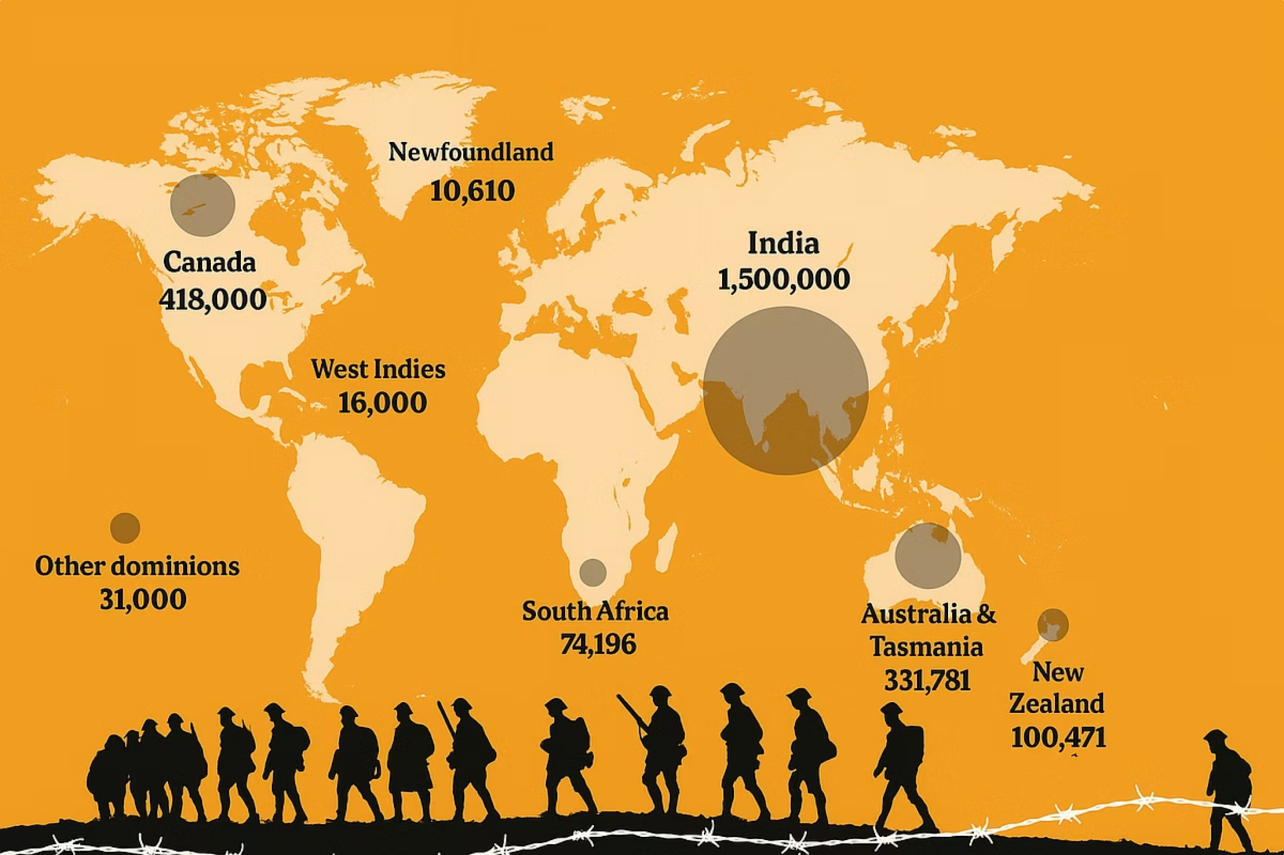
United in Remembrance
During the two World Wars, India made an extraordinary contribution that many people don't know about. Over 2.5 million Indians served in the Second World War, and 1.5 million in the First World War — making it the largest volunteer army in history! These brave men and women came from every corner of India to help defend freedom across the world.
India's contribution was truly remarkable in scale and spirit. Indian soldiers, medics, cooks, drivers, and animal handlers served with courage and dedication.

Slide 2
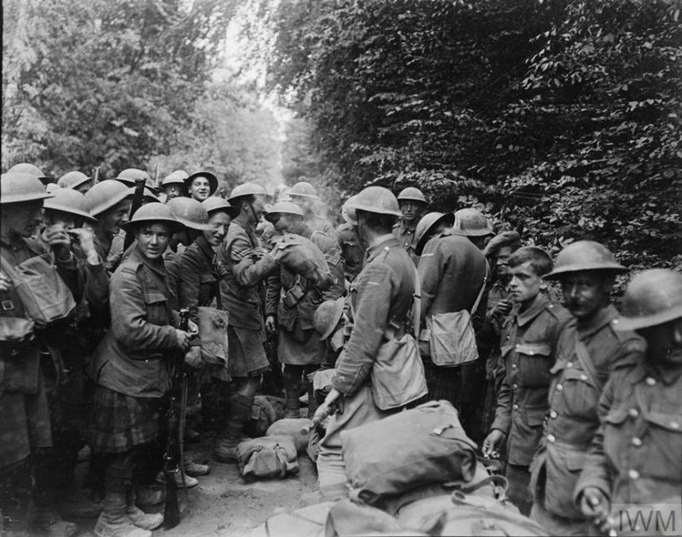
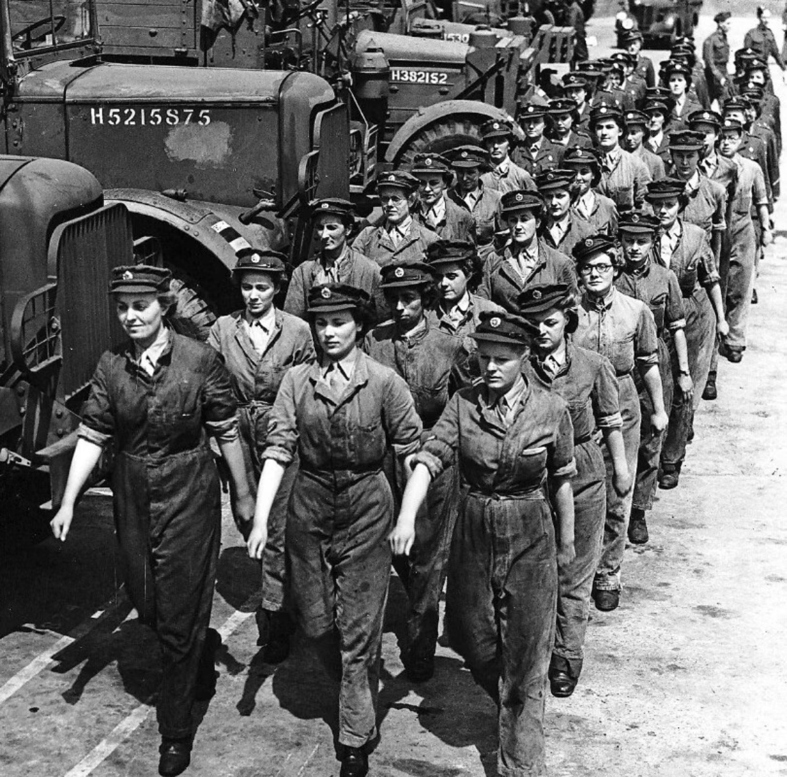
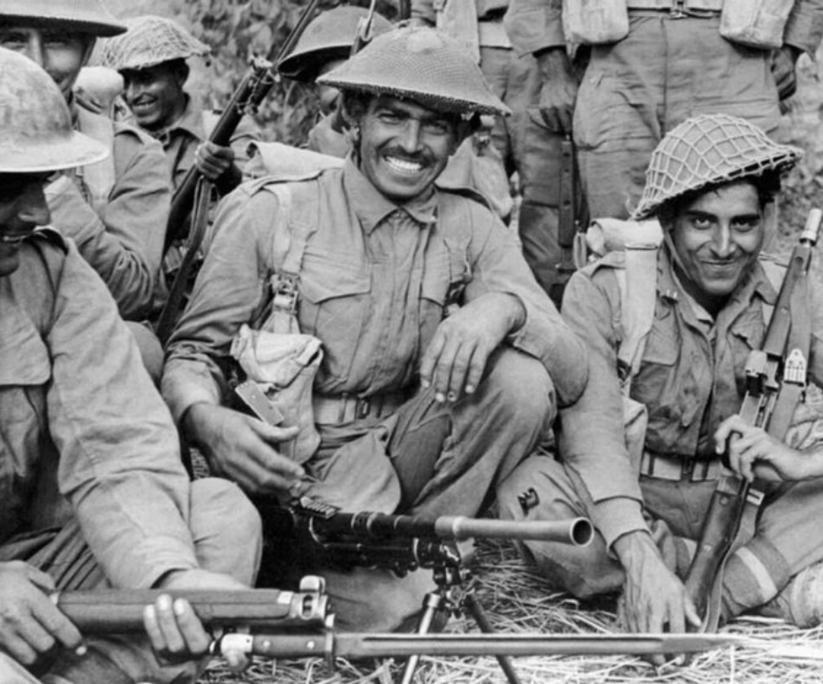
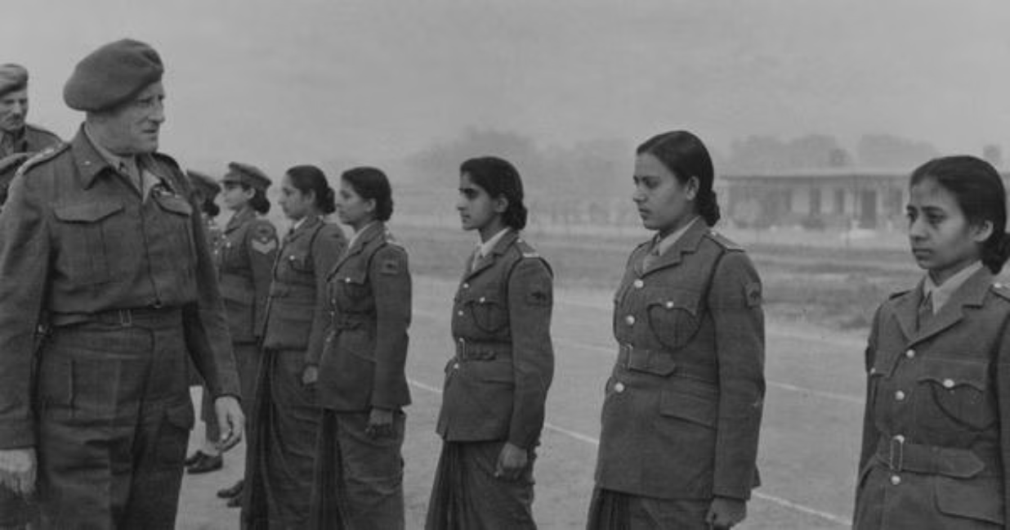
Young British men and women, alongside Young Indian men and women getting ready for war

Slide 3

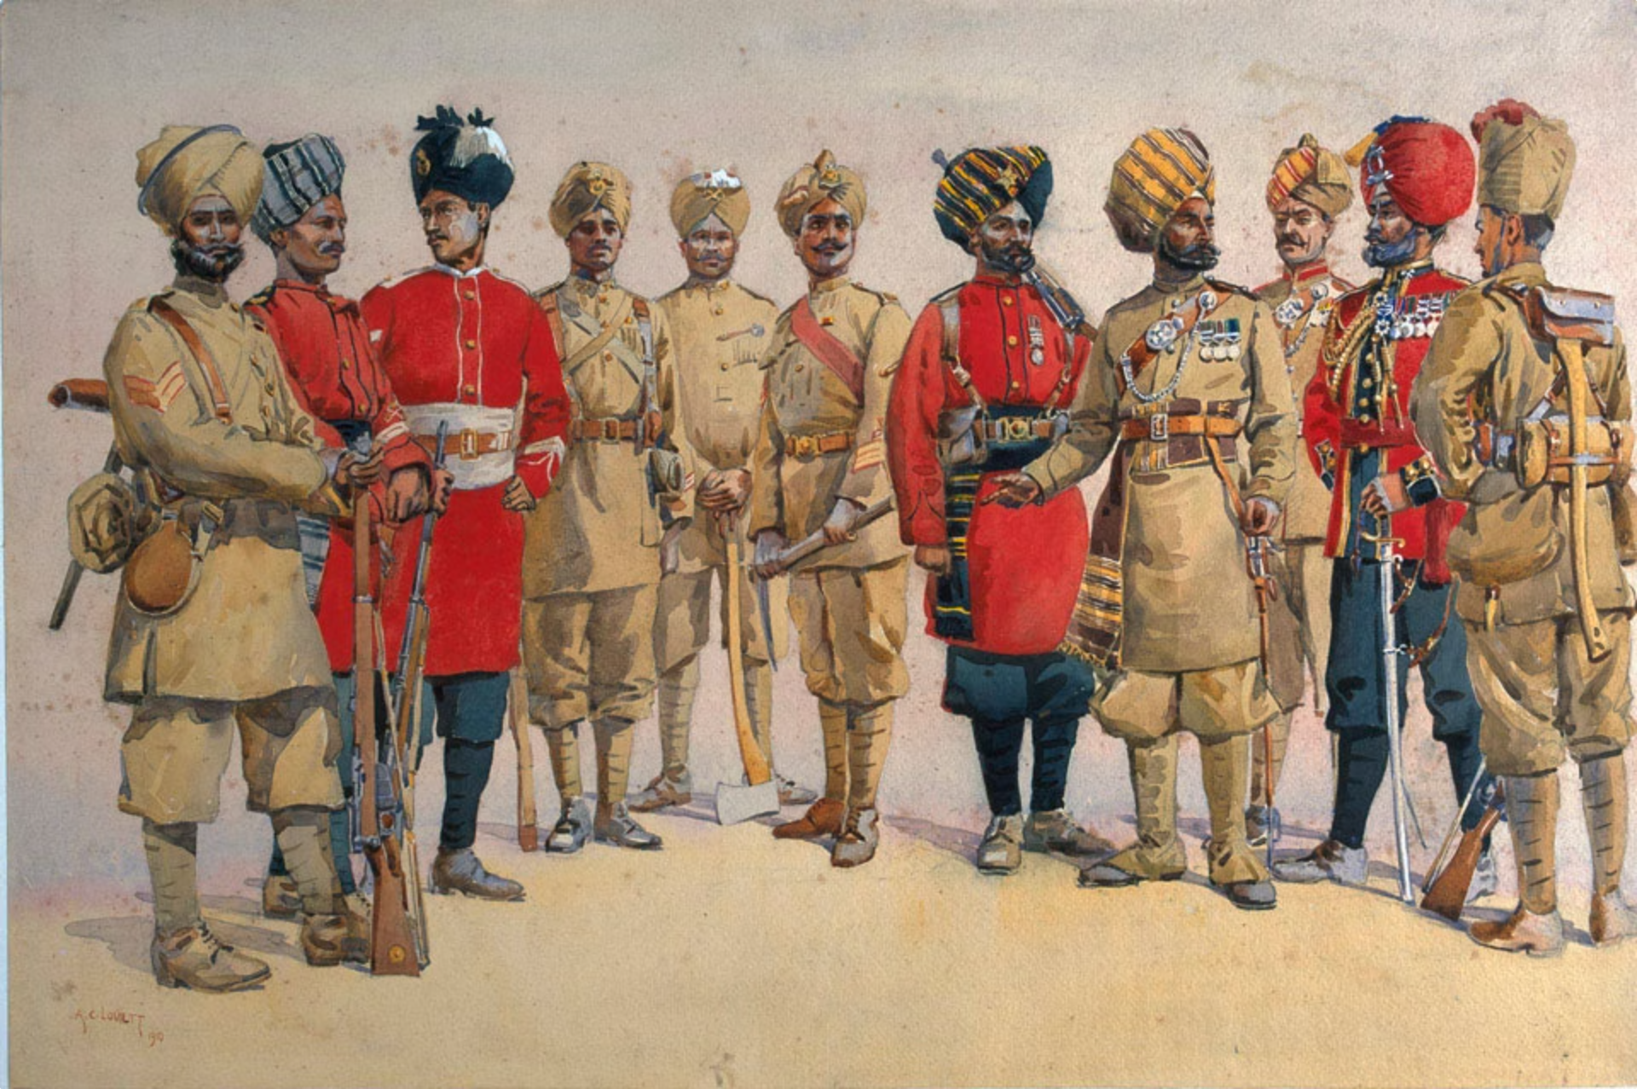
The 89th Punjabis, tracing its origin to 1798, have the unique distinction of serving in more theatres of war than any other unit
Aden (Yemen), where they carried out the first opposed sea-borne assault landing in modern warfare, when they landed at Sheik Saiad Peninsula on 10 November 1914
Egypt, where they defended Suez Canal against the Turkish attack in February 1915.
Gallipoli, where they fought in the Second Battle of Krithia in May 1915.
France, where they endured the horrors of trench warfare from May to December 1915.
Mesopotamia, where the regiment fought with great distinction and was almost decimated in the bloody battles for the Relief of Kut al Amara on the Tigris Front in 1916.
North West Frontier of India, where they served on the Mohmand Blockade in 1917, while recuperating from the casualties suffered in Mesopotamia.
Salonika (Greece), where they arrived in 1918 but were not actively engaged.
Russian Transcaucasia, where they served from 1918 to 1920 as part of the British Expeditionary Force.

Slide 4
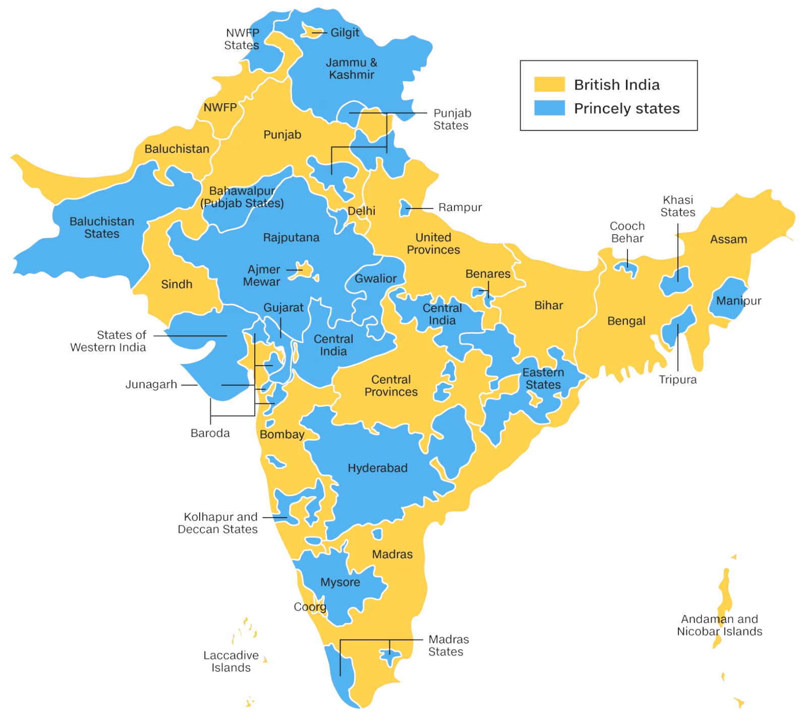
Where did Indian troops come from?
Volunteers came from both regions - Indian kingdoms (Mysore, Jodhpur and Bhagyanagar (Hyderabad)) and British India.

Slide 5
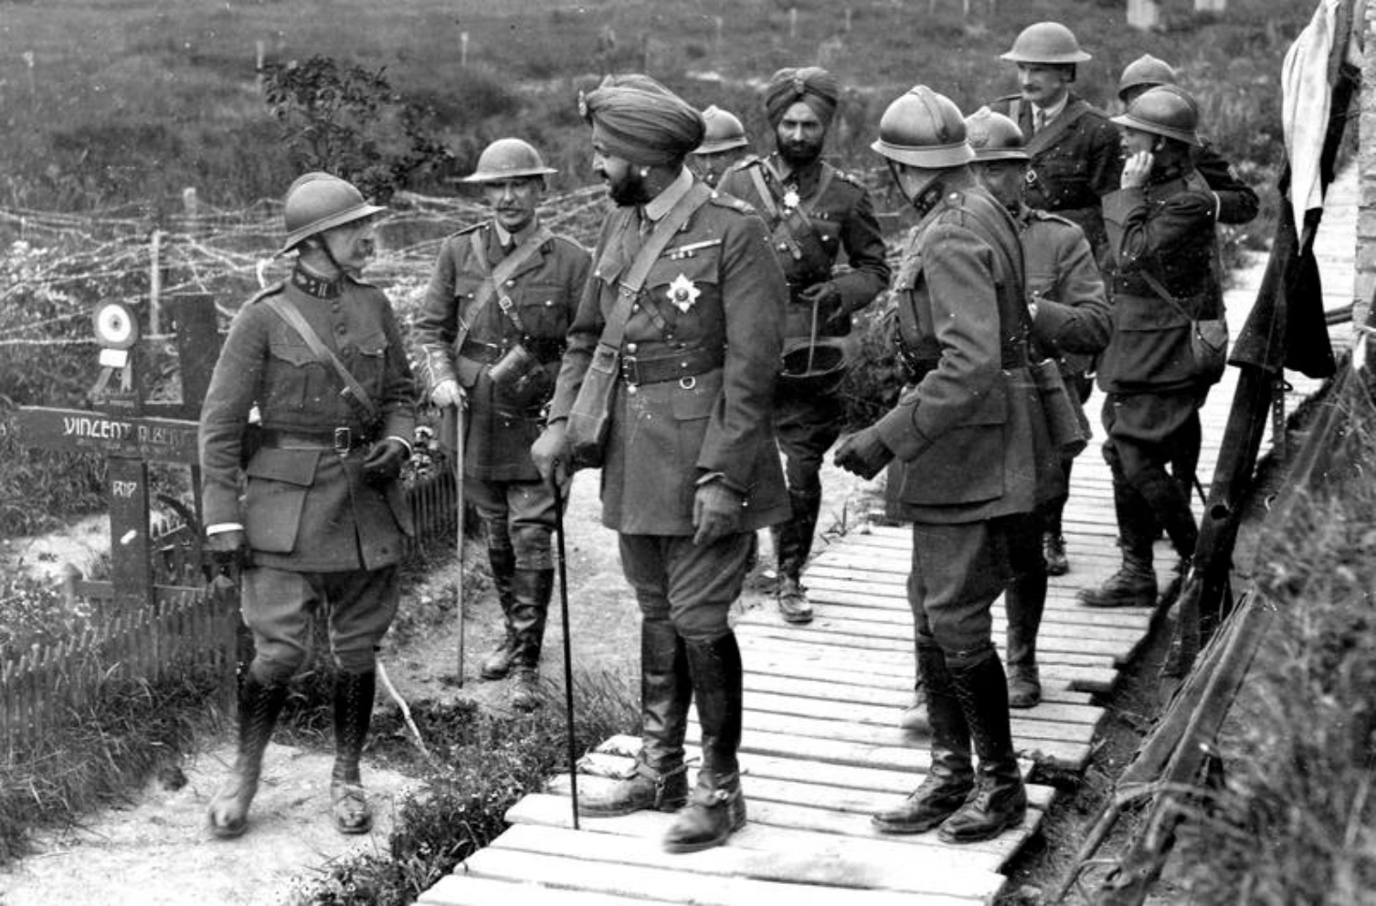
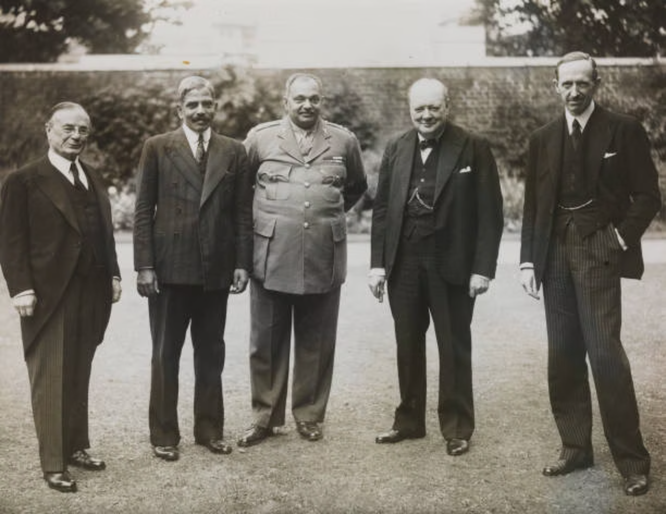
Indians in the Imperial War Cabinet
Sir Bhupinder Singh, Maharaja of Patiala represented the Indian kingdoms in the Imperial War Cabinet of First World War
Sir Digvijaysinhji Ranjitsinhji Jadeja, Maharaja of Nawanagar represented the Indian kingdoms in the Imperial War Cabinet of Second World War
Sir Arcot Ramasamy Mudaliar, Viceroy's Executive Council represented British India in the Imperial War Cabinet

Slide 6
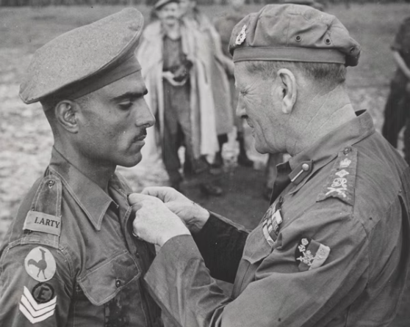
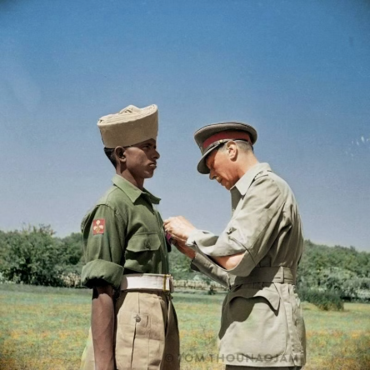
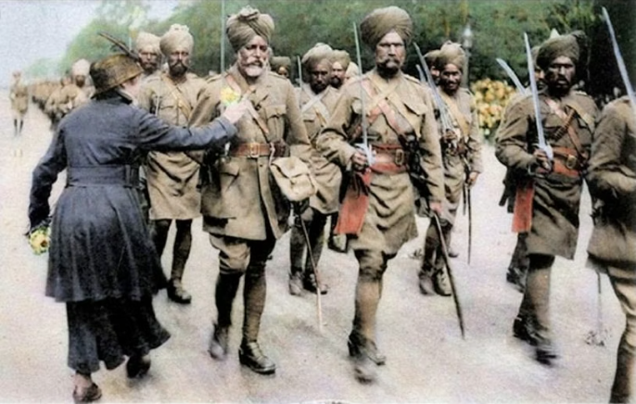
Where They Fought: Theatres of War & Memorials
Indian troops didn't fight in just one place — they served across the entire globe, from the freezing trenches of Europe to the scorching deserts of North Africa, and the dense jungles of Malaysia.
1
2
3
France & Flanders
Mesopotamia & North Africa
Italy & Beyond
During World War I, Witnessing the brutal trench warfare on the Western Front, Indian soldiers displayed immense bravery. The Neuve-Chapelle Memorial in France stands as a solemn tribute to the over 4,700 Indian soldiers who fell there.
In both wars, across the vast deserts of Iraq and North Africa, Indian troops endured extreme heat and harsh conditions, playing pivotal roles in crucial campaigns.
Indian divisions battled through the rugged mountains of Italy and navigated the Mediterranean, actively contributing to the liberation of countries and bringing hope to millions.
Havildar Mohan Lal receiving the Distinguished Service Medal from General Sir Claude Auchinleck, 1944 (NAM. 1981-11-72-54)
King George VI pinning the Victoria Cross on Youngest Indian recipient Sepoy Kamal Ram, 26 July 1944 for his bravery during Battle of Monte Cassino, Italy (IWM NA 17270)
During a 1915 march past of Indian Expeditionary Force in France, a woman pins flowers on to the tunic of one of the soldiers. (IWM Q 70214)

Slide 7
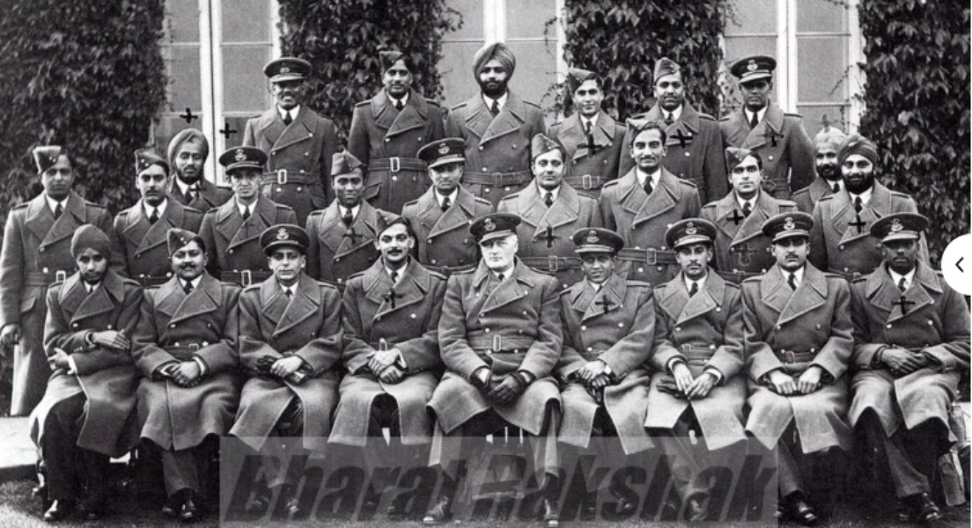
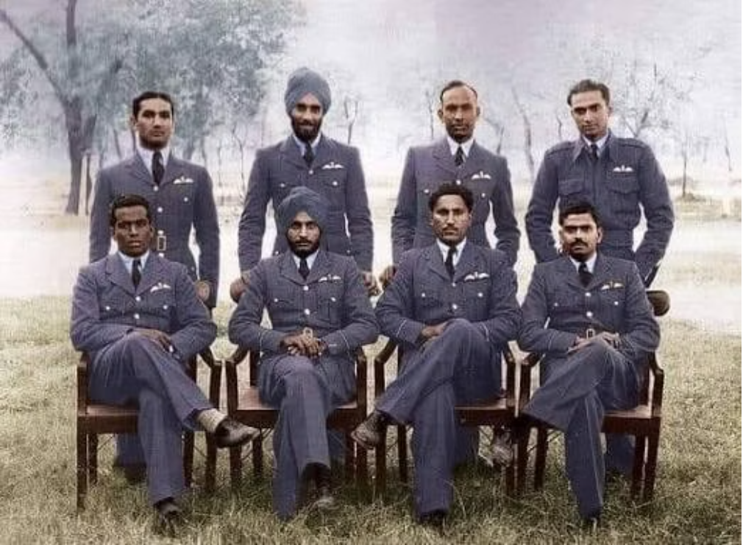
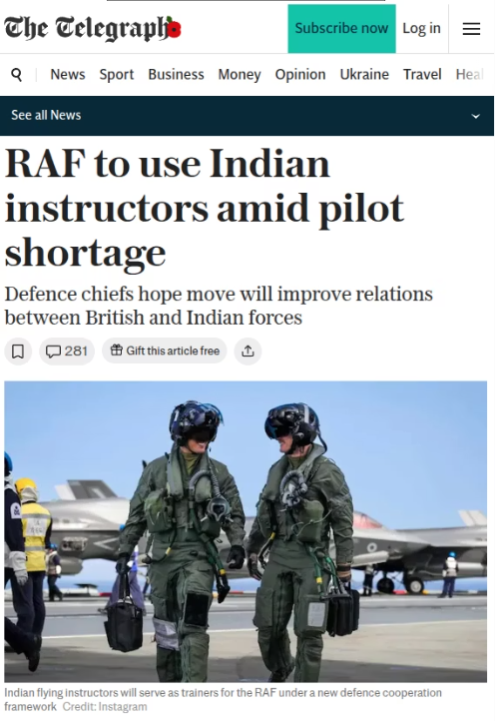
Founded in 1932 with just six officers and 19 airmen, the Indian Air Force took flight under British command and, by 1945, had grown to over 1,600 officers and 26,000 personnel, flying Hurricanes and Spitfires from Malaysia to Britain’s skies during and after Battle of Britain
Today, the IAF commands a fleet of around 1,700 aircraft — over three times the size of the Royal Air Force — flying the indigenous Tejas, French Rafale, and Russian Su-35.
What began in the days of empire has evolved into a collaboration of equals, grounded in mutual respect and a shared pursuit of excellence. Together, they carry forward a legacy of courage and innovation, pointing toward a future of shared strength and soaring potential.

Slide 8
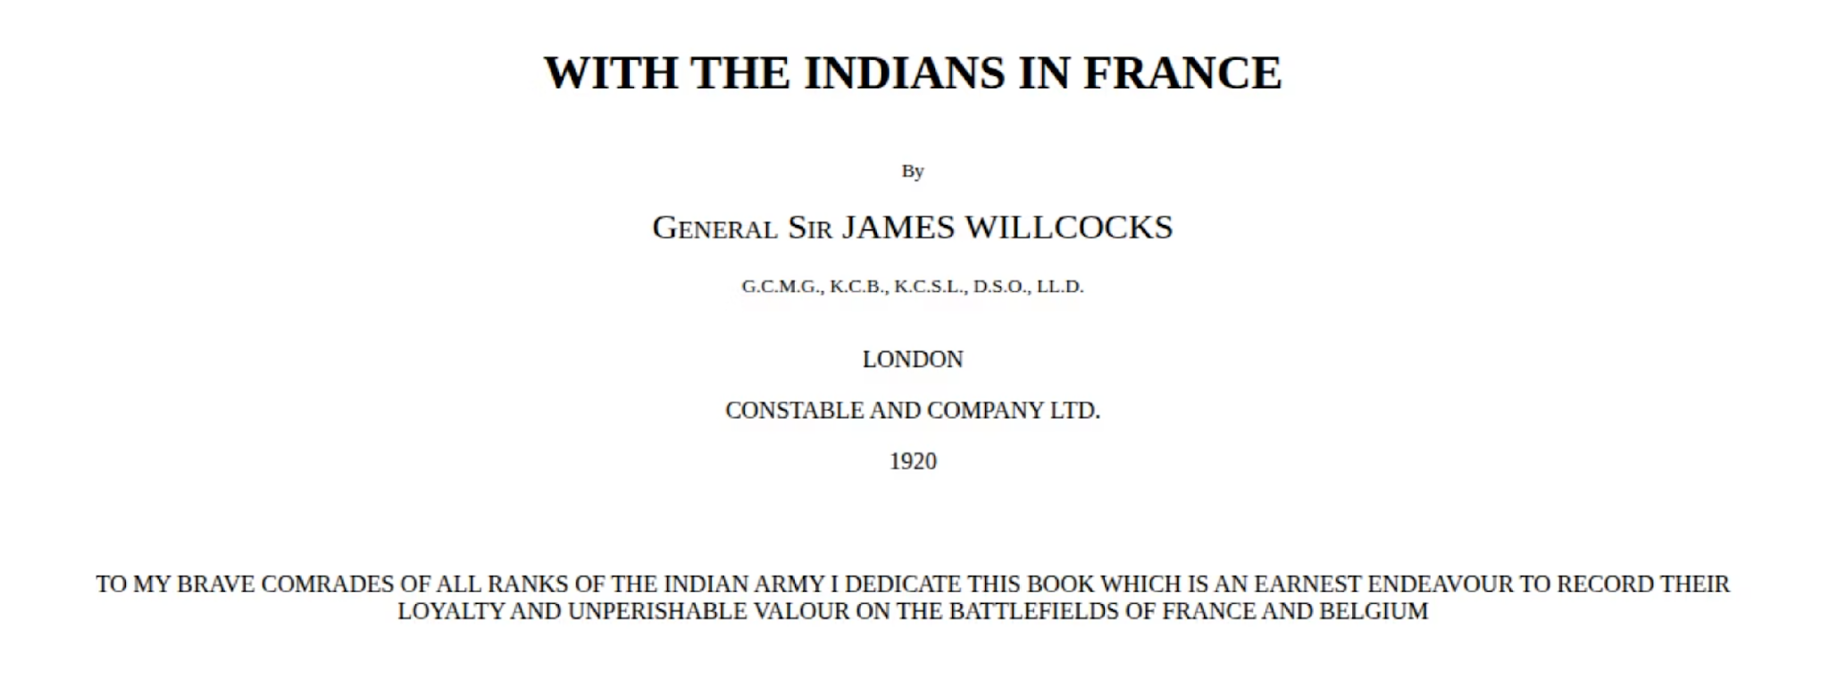
For India’s sons had sealed their oath,
Sealed it with blood across the sea,
From Flanders to Gallipoli,
On Tigris’ banks, on Egypt’s sands,
’Mid Afric’s swamps and hinterlands,
And died in England’s cause.

Slide 9
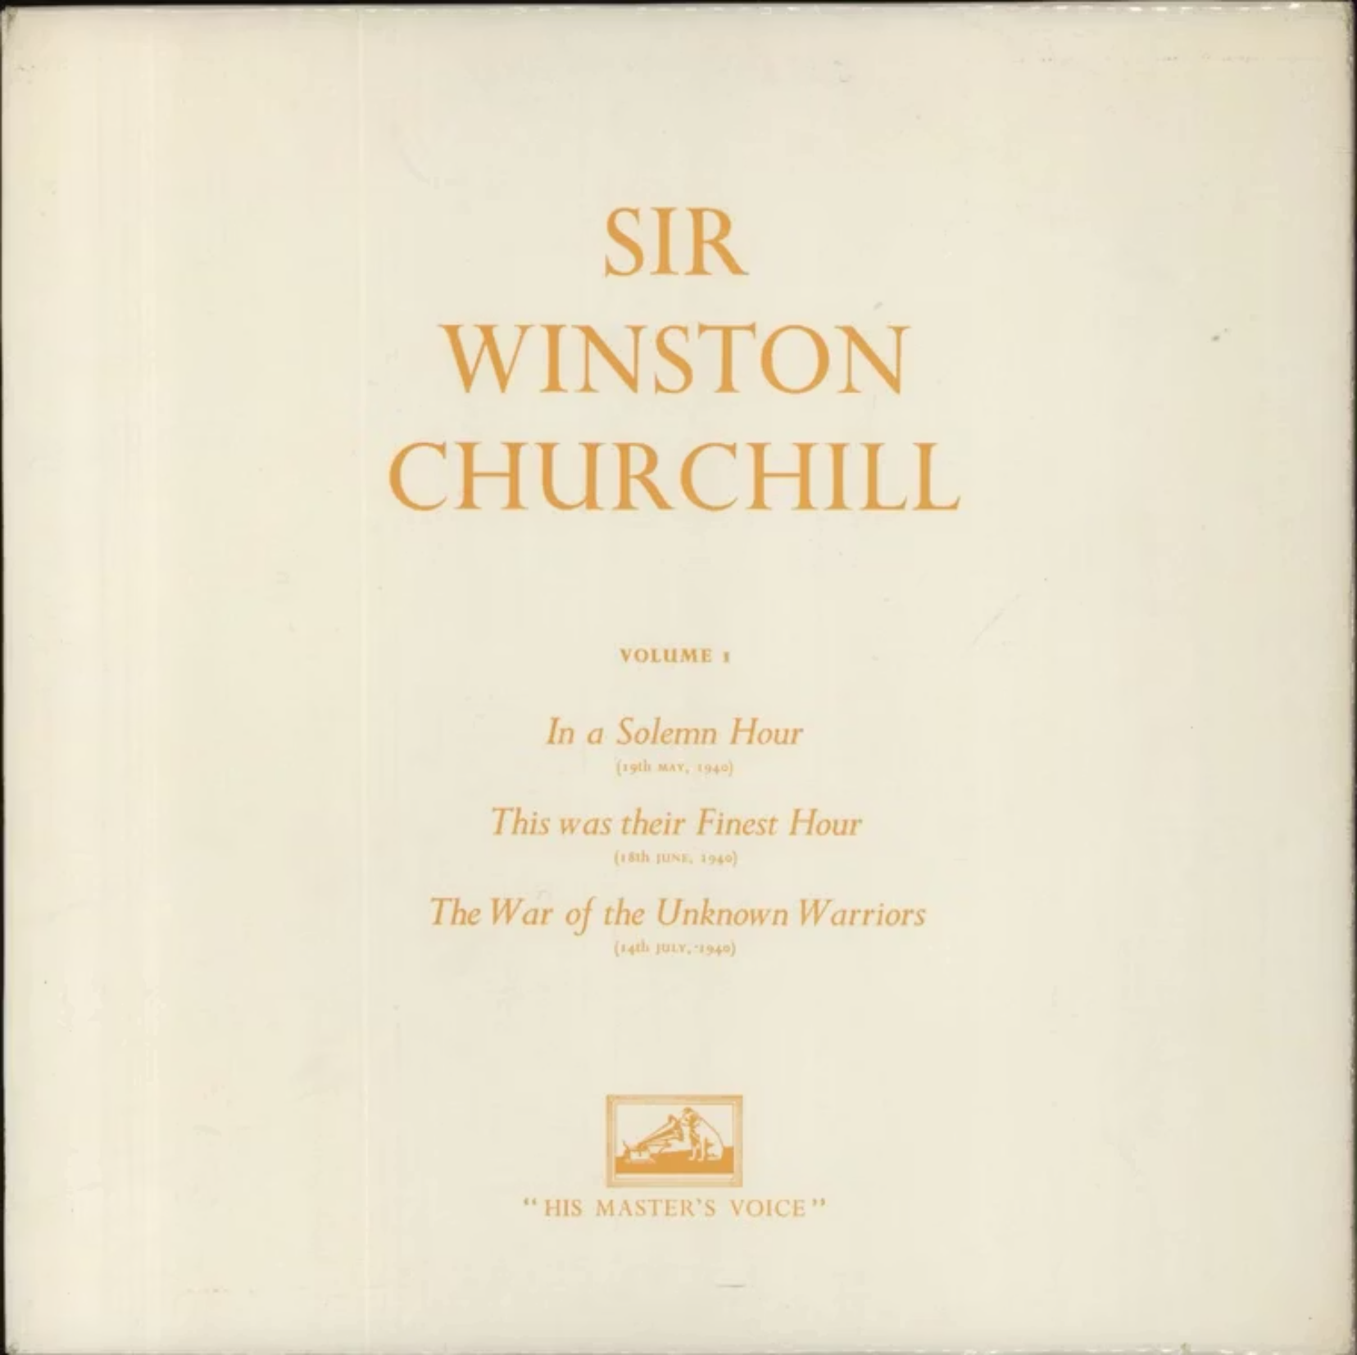
“The unsurpassed bravery of Indian soldiers and officers, shine for ever in the annals of war. Upwards of two and a half million Indians volunteered to serve in the forces…”
“The response of the Indian peoples, no less than the conduct of their soldiers, makes a glorious final page in the story of our Empire…”

Slide 10
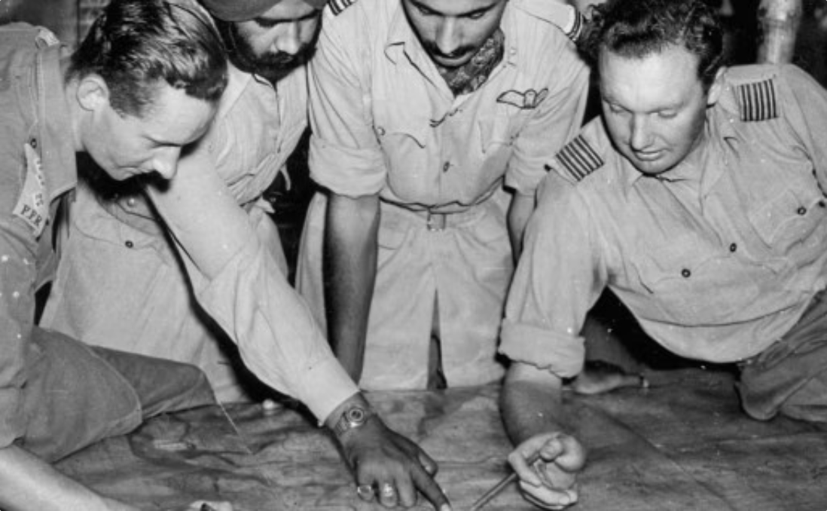
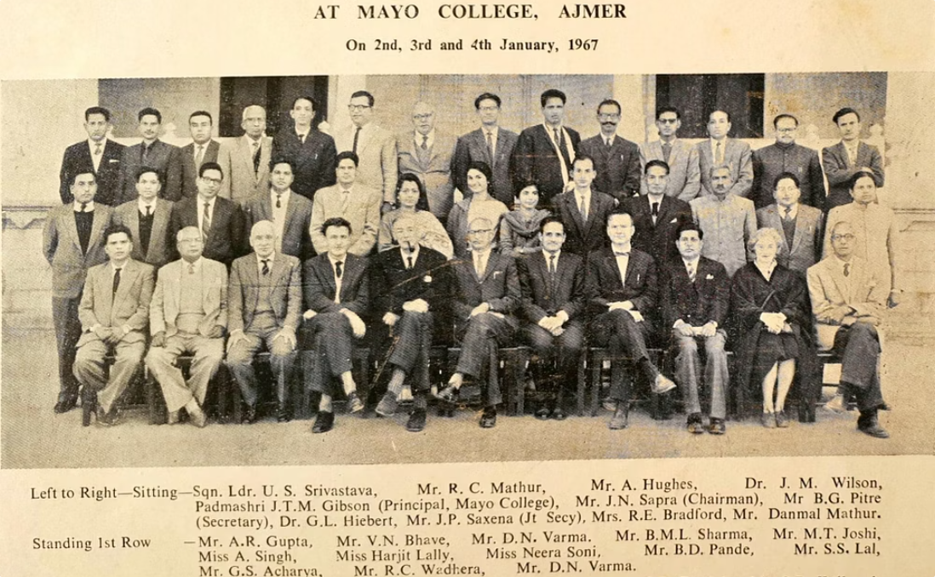
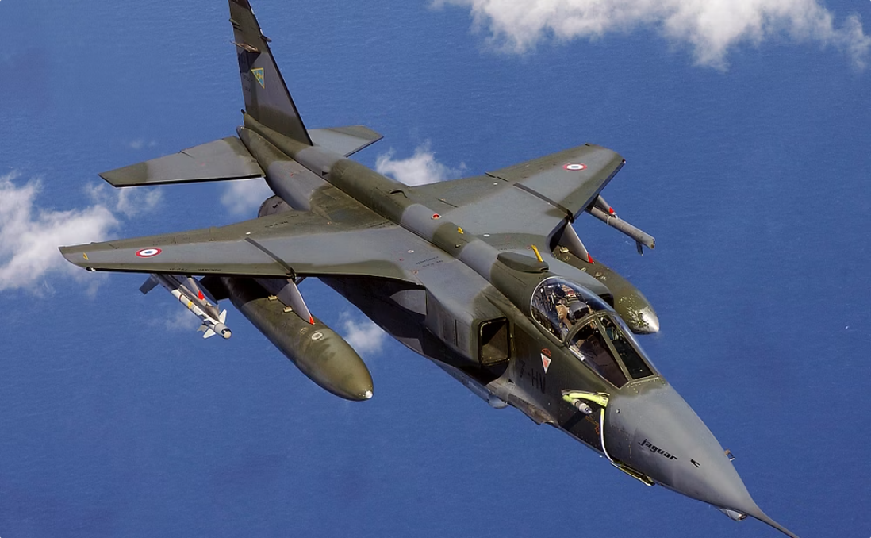
British Officers in Independent India
When India gained independence in 1947, many British officers who had served alongside Indian soldiers chose to stay, helping the newly independent nation build its own army and forging new bonds.
Advisors and Mentors
Shared Knowledge and Training
Bridges to a New Relationship
These officers became invaluable advisors, teachers, and friends to the Indian Armed Forces. They shared their expertise, helping to train a new generation of Indian military leaders.
This unique transition demonstrated that respect and friendship could transcend the end of empire. The bonds forged in battle evolved into a new relationship based on mutual respect, cooperation, and shared values.
Some even retired in India, having grown to love the country and its people. Their continued presence facilitated a smooth transition, some went to become teachers and head masters across India.

Slide 11
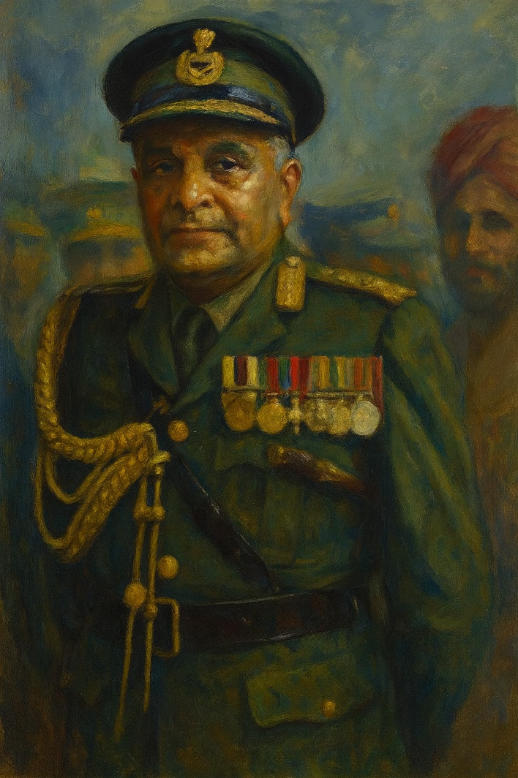
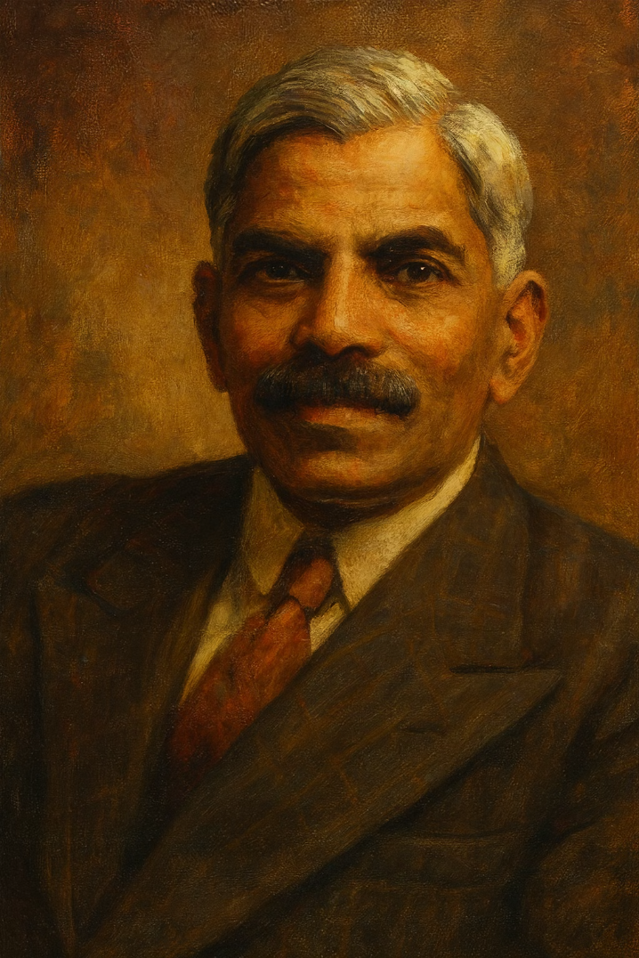
The Generals Who Forged India’s Army
The Diplomats Who Defined India Abroad
In the crucible of World War II, a generation of Indian officers — K.M. Cariappa, K.S. Thimayya, and P.P. Kumaramangalam — earned their mettle under fire. Decorated for courage and leadership, they fought in distant theatres of war, commanding men with distinction and honour.
Educated and trained in the great universities of Britain, India’s first generation of diplomats — men like Sir A. Ramaswami Mudaliar — brought refinement, intellect, and moral purpose to the world stage. During World War II, Mudaliar served on the Imperial War Cabinet and later represented India at the founding of the United Nations, shaping its early ideals of peace and cooperation.
Trained in the finest British military academies, when independence came, these soldiers became architects of a new army — shaping its ethos of professionalism, unity, and service beyond creed or region. From colonial battlefields to a sovereign command, Cariappa, Thimayya, and Kumaramangalam carried forward a tradition of discipline and integrity that defined the Indian Army’s identity in peace and war alike.
As independence dawned, these statesmen transformed from colonial advisers into architects of a sovereign foreign policy. With eloquence and quiet authority, they gave India its global voice — one grounded in dignity, dialogue, and the pursuit of justice among nations.

Slide 12
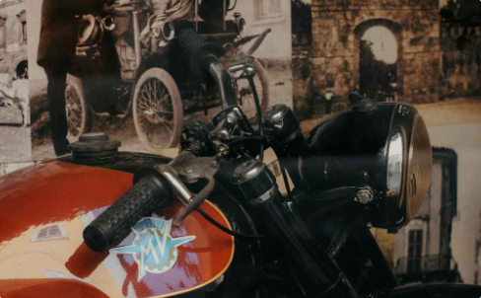
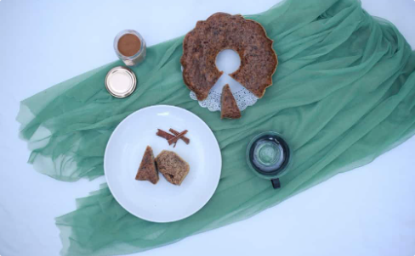
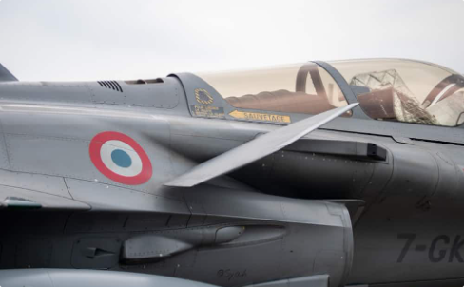
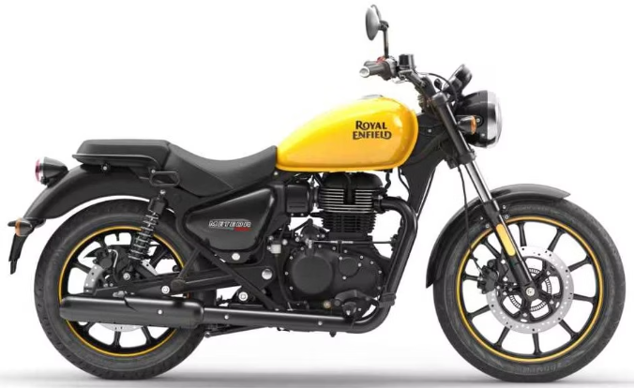


The Legacy Lives On
The connections forged between Britain and India during the World Wars created lasting bonds that we still see today! Many beloved brands and products have British-Indian roots that echo those wartime partnerships.
Royal Enfield Motorcycles
Britannia Biscuits
Anglo-Indian Cuisine
Founded in 1892 in colonial Kolkata, Britannia began as a humble bakery supplying biscuits to British officers. Over the decades, it transformed from an imperial outpost into an illustrious Indian name — a taste of home for millions.
Born in Redditch, Worcestershire, The Enfield Cycle Company built motorcycles that roared through two world wars — tough machines “Made Like a Gun.” Though the British firm closed its doors in 1971, its spirit lived on in India, where Madras Motors kept the Bullet thumping for the Army and beyond.
Once born in colonial kitchens where British tastes met Indian spice, dishes like Bubble and Squeak and the wryly named Bad Word Curry are finding new life in India’s cities. Revived in cafés and home kitchens alike, these Anglo-Indian creations stir nostalgia for a bygone era — a culinary crossroads where East met West over a shared plate.
From army rations to tea-time rituals, Britannia’s biscuits became part of the nation’s daily rhythm. Today, it stands as a multi-billion-dollar FMCG giant and the largest-selling biscuit brand in India — a legacy baked in trust, tradition, and timeless flavour.
What began as an imperial export became an Indian icon — and today, Royal Enfield rides farther than ever, surpassing Harley-Davidson as the world’s best-selling mid-size motorcycle. A legend reborn across continents.
Today, their comeback is more than a trend; it’s a rediscovery of flavour and history, seasoned with memory and modern flair.
The friendship between India and Britain still zooms, crunches, and soars! These connections remind us that partnerships built on respect can last for generations.

Slide 13
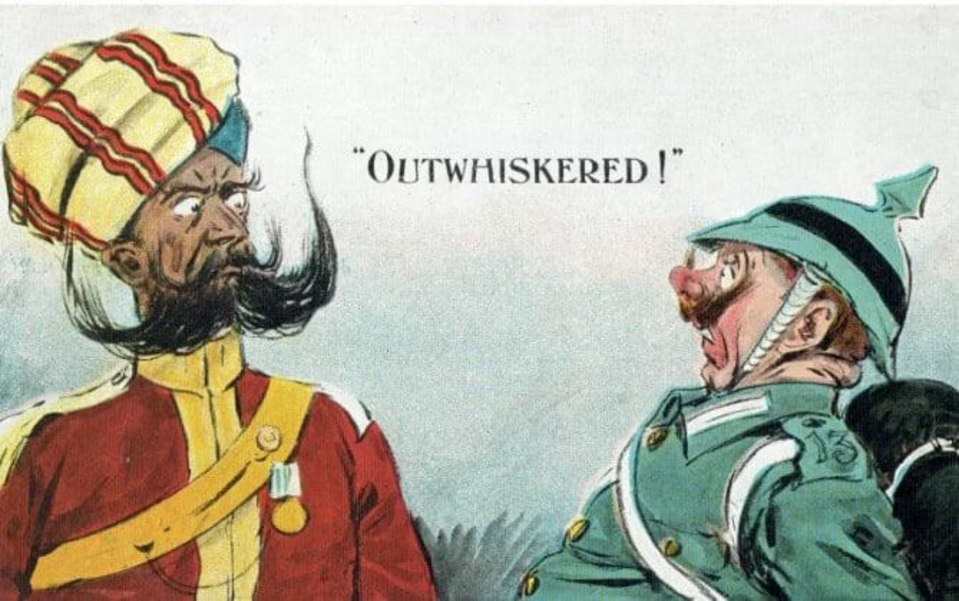
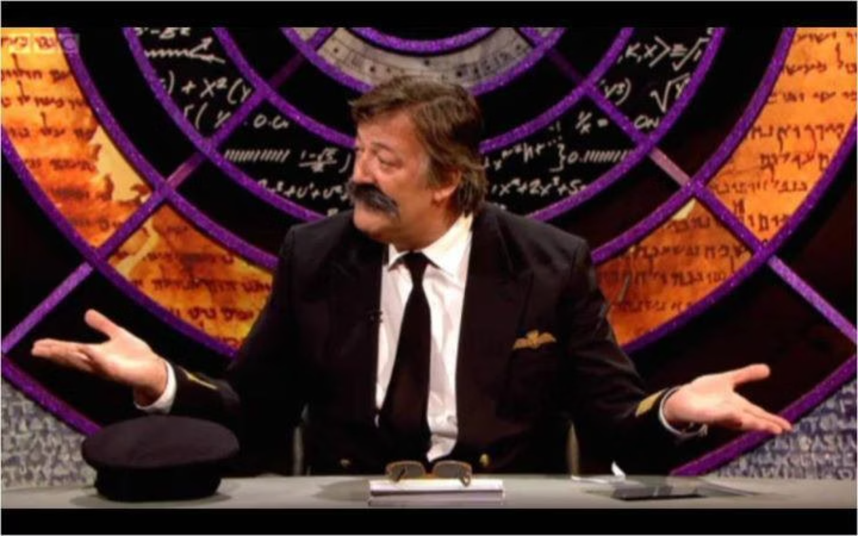
From the Trenches to Today - The 'mooch' marches on!
Here's a fun fact to end on: British and Indian soldiers in both World Wars were famous for their magnificent moustaches!
QI Indian Police Moustaches
In this WWI postcard, an Indian officer’s impressive moustache one-ups his German counterpart. Sometimes, even in the midst of war, a little humour reminds us of the unique character and pride each soldier brought with them.
https://youtu.be/V7izJfU5Lvo?si=5XzNqaBNjxhKPtVr
Remembrance Day is about courage, respect, and remembering — with a smile. We honour those who served with gratitude, celebrating their bravery whilst learning from their stories. Every Poppy, every Marigold we wear represents a life of service, sacrifice, and hope for a peaceful tomorrow.

